Slide 1
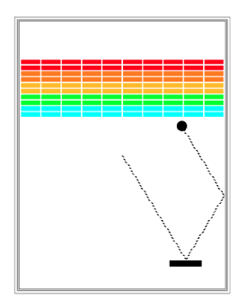
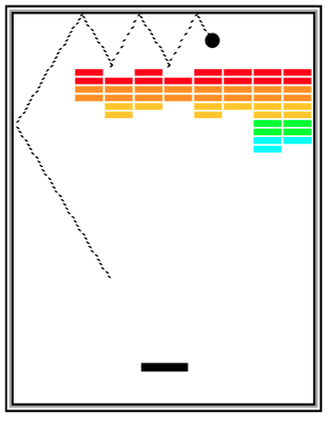

Breakout Lecture 13, July 8, 2021

Slide 2
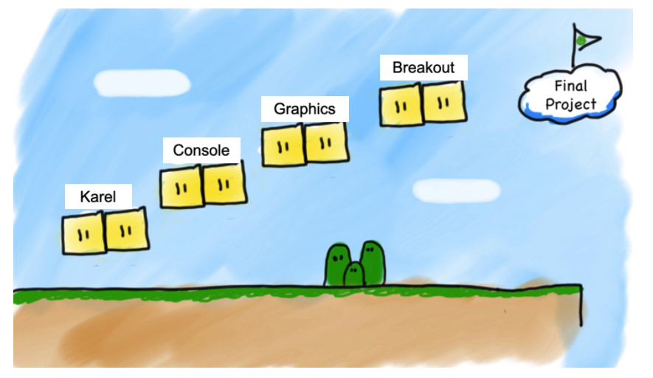

Slide 3
Plan for Today
Review
Breakout!
Development Stages

Slide 4
Animation Loop
def main():
# setup
while True:
# update world
# pause
time.sleep(DELAY)

Slide 5
Moving around
# move shape to some new coordinates
canvas.moveto(shape, new_x, new_y)
# move shape by a given change_x and change_y
canvas.move(shape, change_x, change_y)

Slide 6
Mouse Location
At any time, we can ask the canvas for the current location of the mouse.
mouse_x = canvas.get_mouse_x()
mouse_y = canvas.get_mouse_y()

Slide 7
Mouse Clicks
At any time, we can ask the canvas for a list of mouse clicks that have happened since the last time we asked.
clicks = canvas.get_new_mouse_clicks()

Slide 8
Mouse Clicks
Each element in the list has an x and y coordinate of where that click happened.
clicks = canvas.get_new_mouse_clicks()
for click in clicks:
print(click.x, click.y)

Slide 9
Handle Mouse Events
Ask to canvas for mouse location and handle it events
If there are, then we do something.
If there are not, we do nothing and check again later.
while True:
# Handle any new mouse events
# ...
canvas.update()

Slide 10
Handle Mouse Movement
Ask to canvas for mouse location and handle it
If there are, then we do something.
If there are not, we do nothing and check again later.
while True:
# get mouse location
mouse_x = canvas.get_mouse_x()
mouse_y = canvas.get_mouse_y()
# do_something
DO_SOMETHING()
# update canvas
canvas.update()

Slide 11
Handle Mouse Clicks
Ask to canvas for mouse click and handle it
If there are, then we do something.
If there are not, we do nothing and check again later.
while True:
clicks = canvas.get_new_mouse_clicks()
# each time the user clicks do something
for click in clicks:
DO_SOMETHING()
# update canvas
canvas.update()

Slide 12
find_element_at
find_element_at returns the object at this location on the canvas.
object_here = canvas.find_element_at(x, y)
if object_here:
// do something with object_here
else:
// nothing at that location
Notes:
This is how we can finish dribbleCastle!

Slide 14
Breakout

Slide 15
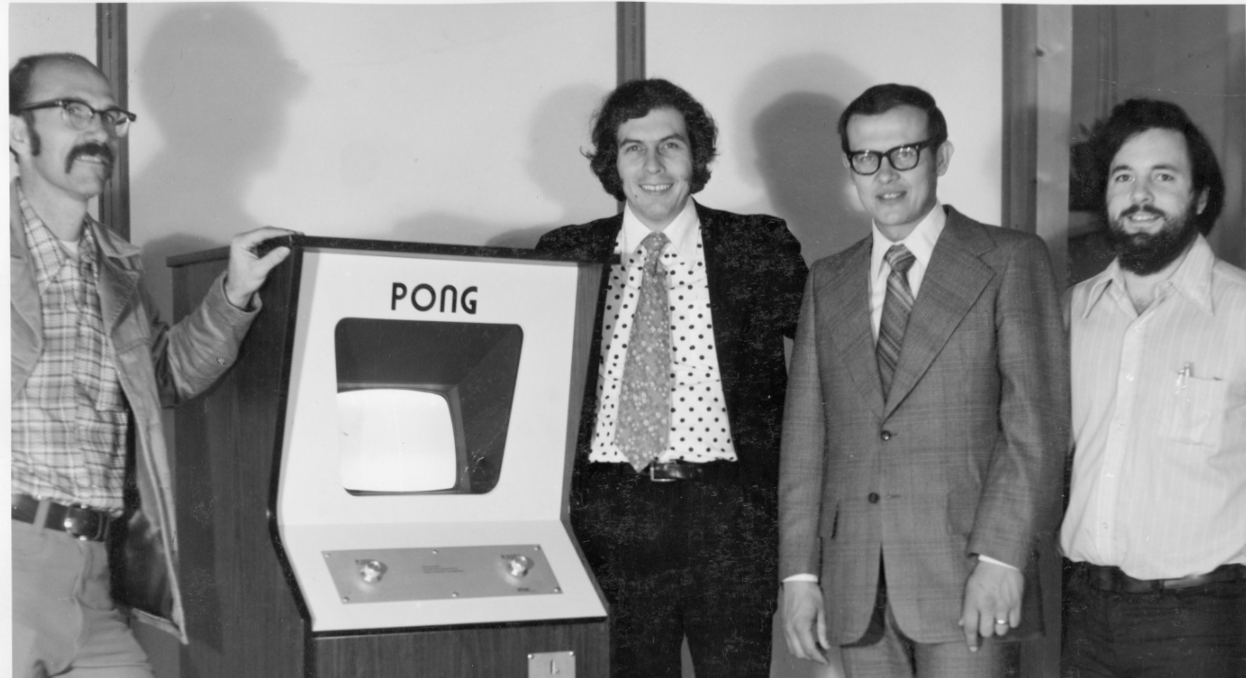
1972
1976
Notes:
1973 the first

Slide 18
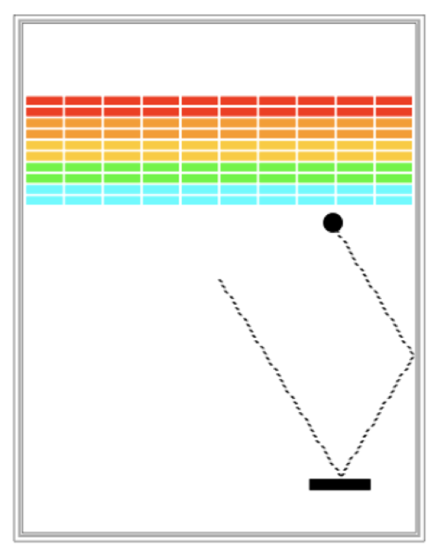
Requirements
Goal is to break all bricks
Paddle moves left and right across the screen with mouse
Ball bounces off paddle, walls and the bricks (breaking them)

Slide 19
Requirements
User has three turns
Ball starts in the center and moves towards bottom at random angle
Turn is over if ball hits the bottom wall. If turns left, game repeats. If out of turns, game is over and player loses
If all bricks broken, the player wins and game ends!

Slide 20
Big program. Do it in parts
1
2
3

Slide 21
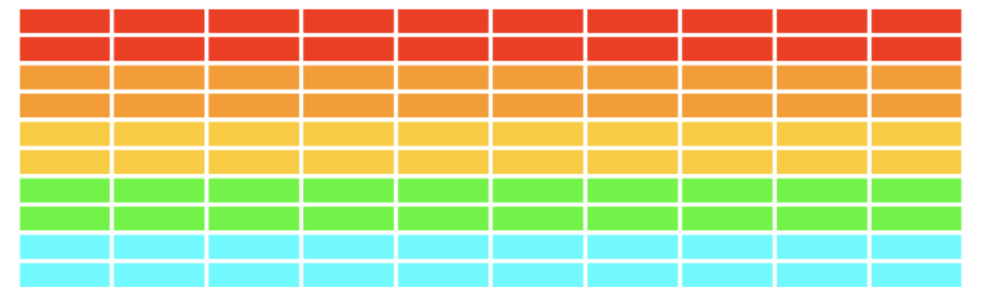
1. Create Bricks
Number, dimensions and spacing of bricks as constants
Calculate x coordinate of the first column - so that bricks are centered
Colors of bricks - red, orange, yellow, green and cyan

Slide 22
1. Create Bricks
Can you decompose this even further?

Slide 23
2. Add a bouncing ball
Create ball in center
Keep track of velocity of ball
change_x = 10
change_y = 10
Get ball to bounce around, ignoring bricks + paddle
What happens to velocity when ball bounces?

Slide 24

3. Add the paddle
Paddle is a filled rectangle
Need to make center of paddle track the mouse
mouse_x = canvas.get_mouse_x()
Paddle

Slide 25
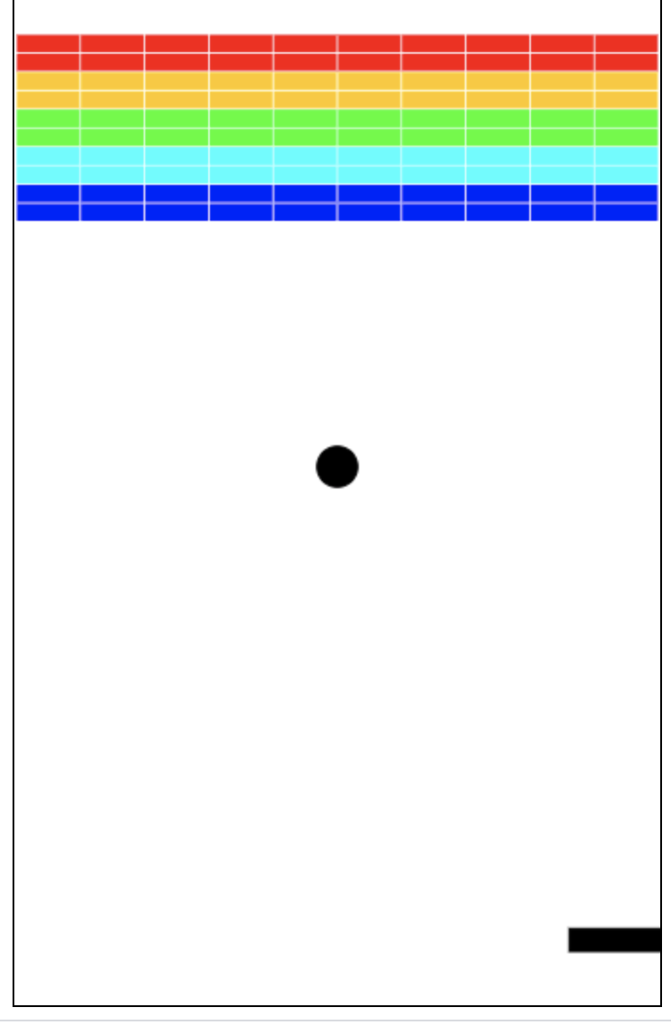
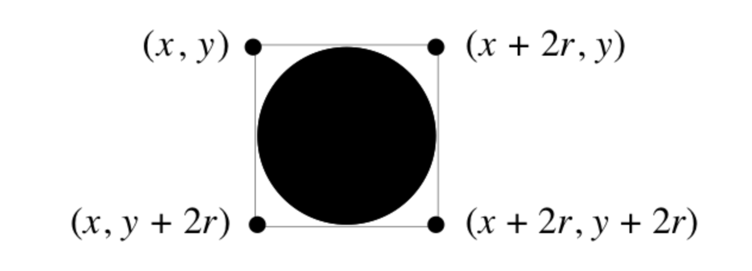
4. Check for collision
Did ball collide with another object in the window
canvas.find_overallapping (x1, y1, x2, y2)
Return list of objects overlapping with rectangle whose upper left is (x1, y1) and bottom right is (x2, y2)

Slide 26
Part 4 - Check for collision
Use of list
# this graphics function gets the location of the ball as a list
ball_coords = canvas.coords(ball)
# the list has four elements:
x_1 = ball_coords[0]
y_1 = ball_coords[1]
x_2 = ball_coords[2]
y_2 = ball_coords[3]
# we can then get a list of all objects in that area
colliding_list = canvas.find_overlapping(x_1, y_1, x_2, y_2)

Slide 27
Part 4 - Check for collision
Collide with a paddle
Bounce ball towards up
Collide with a brick
Bounce ball towards down
Flip change_y direction
Remove brick from the screen
canvas.delete(square) # deletes the object called square
Count the number of removed bricks
That’s how you know you hit the last brick

